Slide 1
V10 Fundamentals
Partial Page Update

Slide 2
Assessment Creation process
Objective
At the end of this session you will be able to :
Identify properties associated with dynamic widget behaviors
Describe the common ways to configure a partial page update
Enable and configure targeted Post on change for a widget (v10.0.1 or below)

Slide 3
Widget Properties

Slide 4
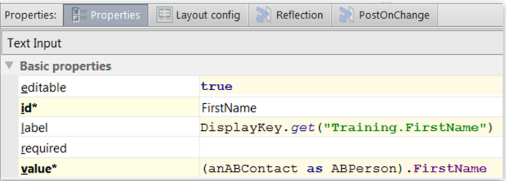
Two kinds of widget properties
Static Property
Evaluates a static value that is immutable, never changes
Id requires a static value
Dynamic Property
After a user navigates to a page or clicks update, evaluates an expression and returns a value
Editable requires Boolean expression
Label returns a string expression
Value returns an object expression

Slide 5
Dynamic properties evaluate expressions
Available – Boolean expression which if false grays out the widget and its children
Editable – Boolean expression which, if false, makes the widget and its children read-only
Required – Boolean expression which, if true, then a value must be filled out by the user
Visible – Boolean expression which, if false, completely hides the widget and its children

Slide 6
Dynamic property and dynamic behavior
Dynamic Property
After a user navigates to a page or clicks Update, the widget property expression is evaluated
Reflects committed data
Dynamic Behavior
While a user changes business data, the widget property expression evaluated
Reflects uncommitted changes to data
Applicable to the dynamic properties of a widget
Partial page update configuration required
Two types – Layout re-render and Data Only

Slide 7
About Partial Page Update

Slide 8
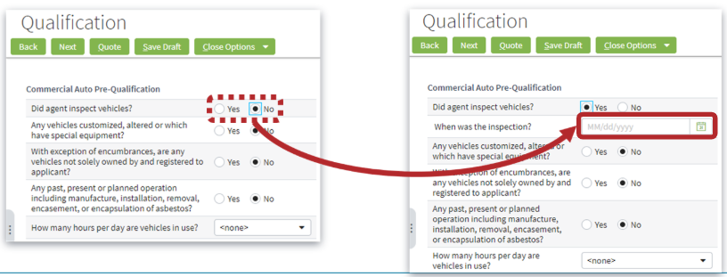
Partial Page update : Layout re-render
Responds to a user changing business data while it happens and changes the layout of widgets on the screen
Example -
While a user changes the ‘Did agent inspect vehicles?’ field to Yes, a secondary question and Date input widget becomes visible

Slide 9
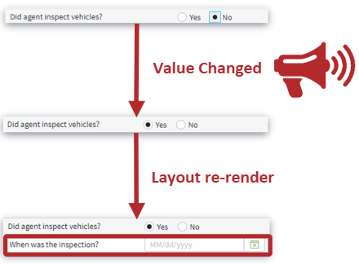
Partial Page update : Layout re-render
Layout re-rendered for the page
No data committed
Applies to the following dynamic widget properties
Visible
Editable
Available
Required

Slide 10
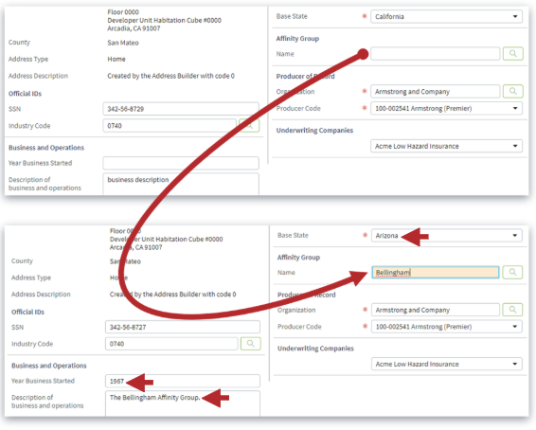
Partial Page update : DATA_ONLY (v10.0.1 and below)
Responds to a user changing business data while it happens
Not after the user navigates to the page
Not after the user commits or tries to commit the data
Example
While a user changes the Affinity Group Name field, values for the other fields are rendered with changes (readonly in UI)

Slide 11
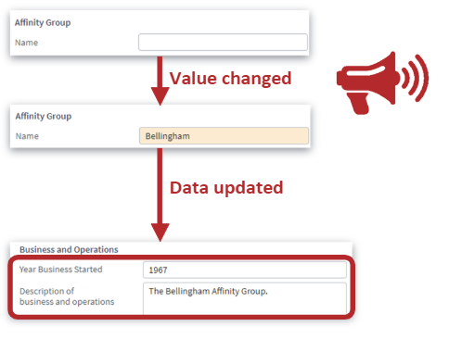
Partial Page update : DATA_ONLY (v10.0.1 and below)
Data is updated for the page
No data committed
Applies to only one dynamic widget property :
value

Slide 12
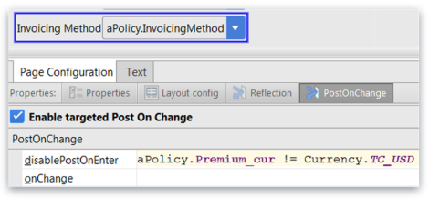
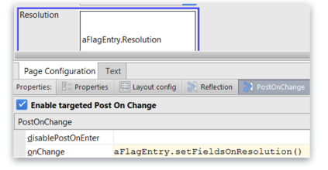
Post on change properties
disablePostOnEnter
If evaluated true when page is rendered, this field won’t trigger Post on change
Default is false
OnChange
Defines a gosu expression to invoke when user changes the value of the widget
Causes immediate post back to the server

Slide 13
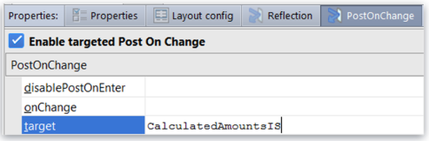
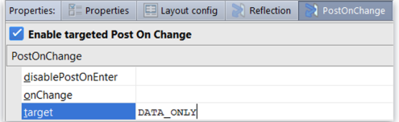
Target Property (v10.0.1 and below)
Layout re-render
Widget ID
Target area re-rendered
All editable data refreshed
Widgets can also be grouped and parent container can be targeted
onChange
DATA_ONLY
No layout re-render
All editable data refreshed
Best performing

Slide 14
Thank you

